Slide 1
Disinfection By-Production Formation Prediction

Slide 2
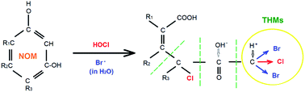
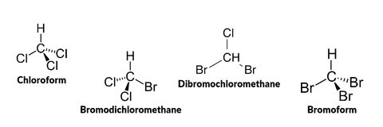
What are disinfection By-Products?
Formed when chlorine reacts with natural organic matter
Have been linked to bladder cancer
Regulated in drinking waters

Slide 3
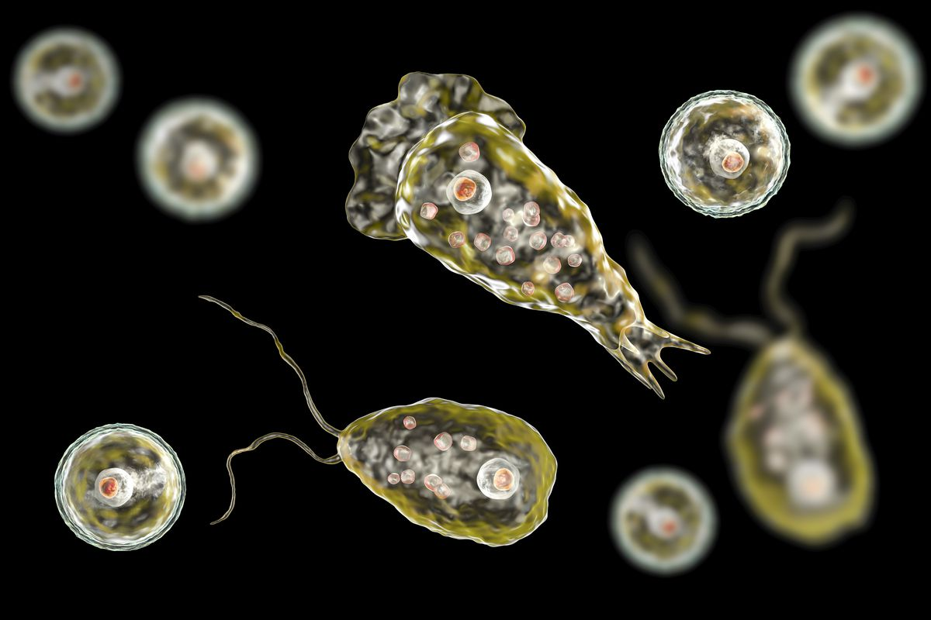
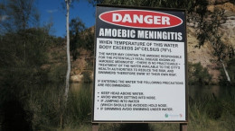
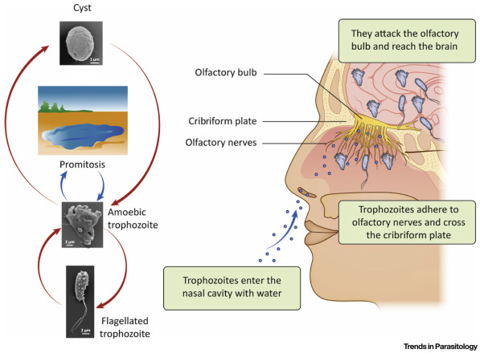
Naegleria Fowleri

Slide 4
Parameters for model
Dissolved Organic Matter (FOC)
UV absorbance (UVA)
Chlorine Dose Rate
Chloride (Cl)
Bromide (Br)
pH
Conductivity (COND)
30 min Chlorine Decay
Turbidity
Colour

Slide 5


Notes:
Go to notebook

Slide 6
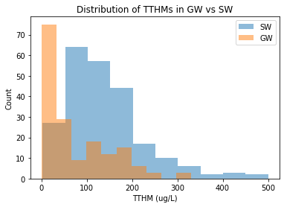
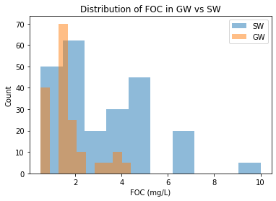
Data Exploration

Slide 7
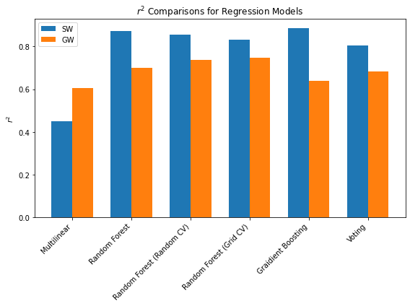
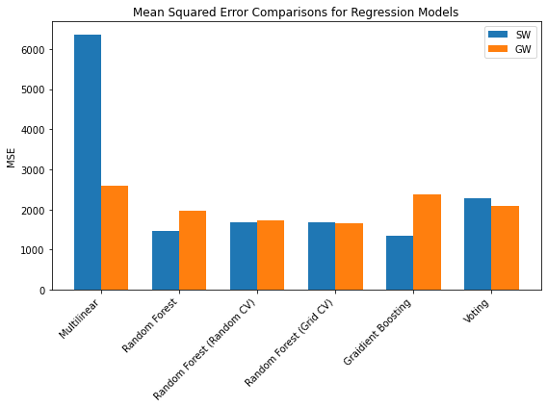
Model Selection
Notes:
In general surface water samples produced better models

Slide 8
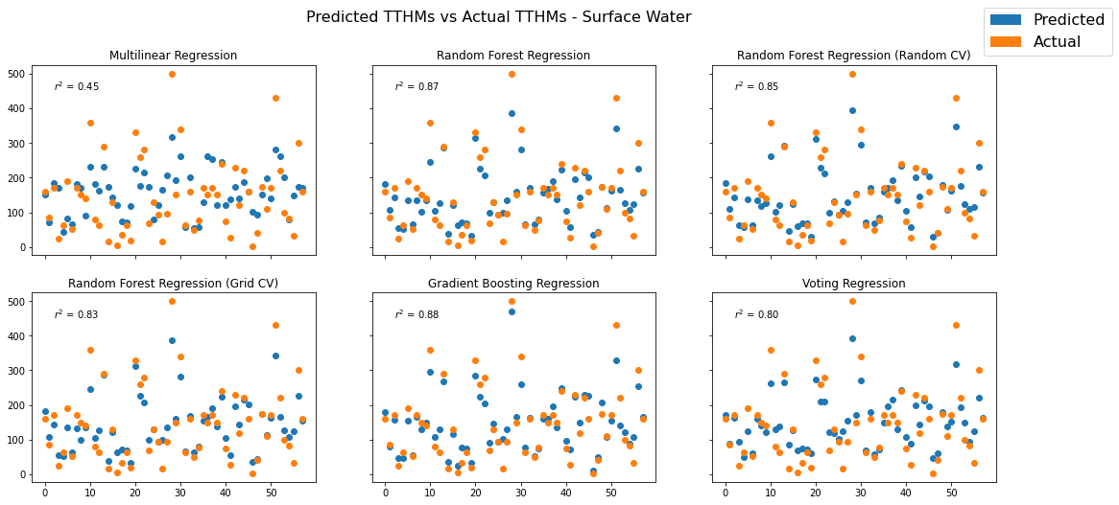
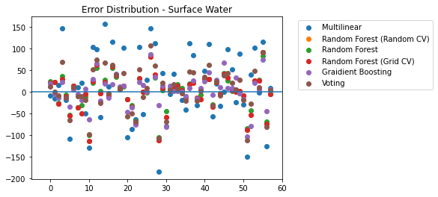
Model Selection

Slide 9
Chosen Models
Surface Water
Ground Water
Gradient Boosting Regression Tree
Key Parameters:
Dose Rate
FOC
UVA
Trimmed Model
Random Forest Regression (Grid CV)
Key Parameters:
Dose Rate
30 minute Decay
Colour
No Trimmed Model

Slide 10
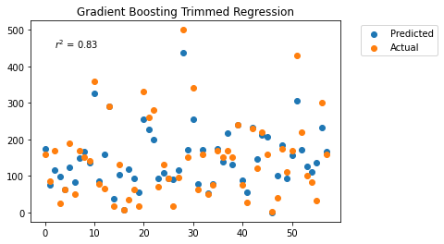
Trimmed Model
Uses only
Dose Rate which can be estimated
UVA and FOC – cheaper and faster
MSE – 1943 (sqrt – 44)
R² – 0.83
Notes:
Go to app

Slide 11
Questions?

